Slide 1
GAME IDEAS

Slide 2
1.Bullet hell and Vertically scrolling shooters
Manic Shooter (also known as "Bullet Hell" or "Danmaku"):
This subgenre is known for its extremely high number of enemy projectiles, often filling the screen with complex, dense patterns that the player must navigate through. These games emphasize memorization, fast reactions, and precise control. They often feature intricate scoring systems and a high level of difficulty. Manic shooters are very popular in Japan, with notable series including "Touhou Project" and "DoDonPachi.“
Vertically Scrolling Shooter:
In these games, the action typically scrolls upward from the bottom to the top of the screen (hence "vertically scrolling"). The player controls a spaceship or aircraft, navigating through levels and fighting enemies and bosses. This subgenre includes many classic arcade games from the 1980s and 1990s, such as "1942" and "Raiden." These games are characterized by their straightforward gameplay, where the primary goal is to dodge enemy fire and destroy as many enemies as possible.
Both subgenres are part of the broader category of shoot 'em ups, a genre that emphasizes shooting and dodging enemies, with various subgenres differing primarily in player perspective and gameplay style.

Slide 3
1.Bullet hell and Vertically scrolling shooters
"Manic shooter"（又称为“bullet hell”或“danmaku”）和"Vertically scrolling shooter"是两种不同类型的射击游戏，每种都有其独特的特点和游戏风格。
Manic Shooter (Bullet Hell/Danmaku):
特点：在这类游戏中，屏幕上通常充满大量的敌人子弹，这些子弹以复杂的模式排列，玩家需要在狭窄的空间中灵活移动，以避开密集的弹幕。这些游戏的重点在于弹幕避难和精确的控制。
挑战：弹幕密集，要求玩家有非常高的反应速度和精准的操作。
代表作：系列如“东方Project”（Touhou Project）和“怒首领蜂”（DoDonPachi）。
Vertically Scrolling Shooter:
特点：在这类游戏中，游戏画面自顶向下滚动，玩家控制的飞船或角色位于屏幕底部，并向上射击。游戏中的敌人通常从屏幕顶部出现，朝玩家移动。
游戏流程：这些游戏通常分为多个关卡，每个关卡结束时通常会有一个Boss战。
代表作：如“雷电”（Raiden）和“1942”。
两种类型的游戏都属于射击游戏的范畴，但焦点和玩法上有所不同。Manic shooter强调的是避弹和生存，而Vertically scrolling shooter则可能更侧重于整体的射击体验和关卡设计。

Slide 4
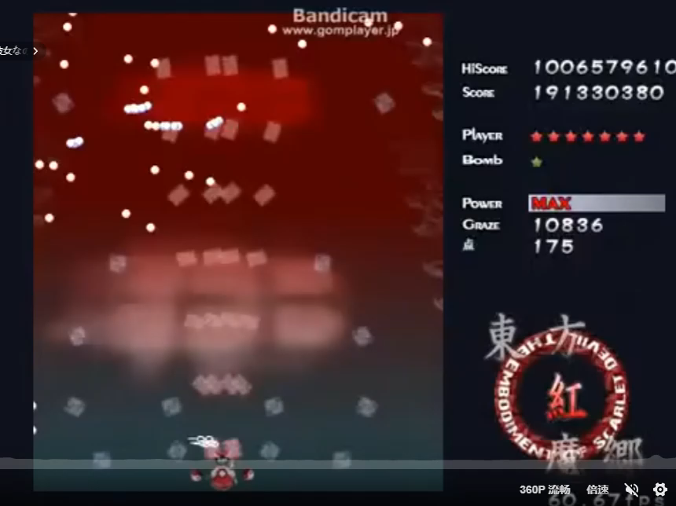
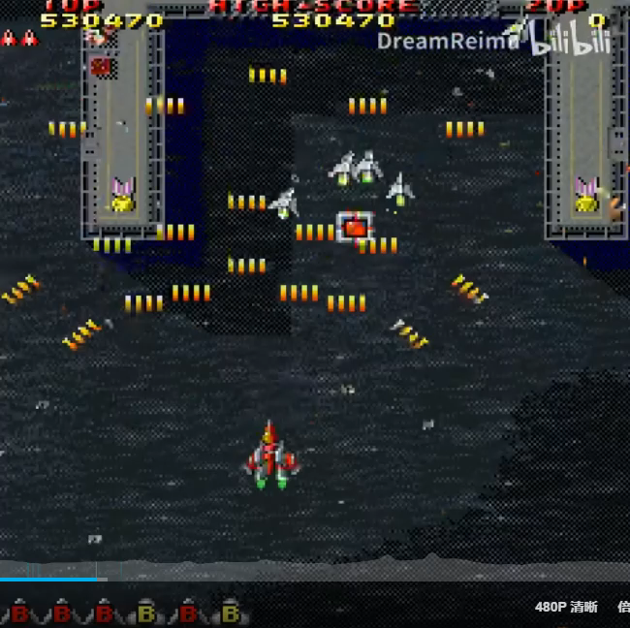
1.Bullet hell and Vertically scrolling shooters
Examples:
Bullet Hell: Vertically Scrolling Shooter:
Touhou Project (东方Project) Raiden(雷电)

Slide 5
Challenges:
Level Design.
Each level should have a unique rhythm, including the timing of enemy appearances, the density of bullet patterns, and the arrangement of Boss battles. The difficulty of the game should gradually increase, allowing players to enjoy the challenge while having enough space to learn and adapt to the game.
Character Design.
To maintain player interest, it is important to provide a variety of enemy behaviors and bullet types. Each level or enemy should have its unique attack pattern. The character controlled by the player should also have their own unique abilities and be able to become increasingly powerful as the game progresses.
Bullet Hit Detection and Optimization.
Since there could be hundreds or even thousands of bullets and other elements on the screen at the same time, performance optimization is crucial. The game must be able to handle a large number of objects and collision detections while maintaining a smooth frame rate.
Storyline.
Although the focus of the game is action, engaging level design and an enthralling storyline can greatly enhance the gaming experience. Designing unique levels and Boss battles, as well as integrating story elements into the game, can make the game more rich and attractive.
Multiplayer (Optional).

Slide 6
Challenges:
1.关卡设计。
每个关卡都应该有独特的节奏感，包括敌人的出现时间、弹幕的密度、以及Boss战的安排。游戏难度应该逐渐增加，让玩家在享受挑战的同时也有足够的空间学习和适应游戏。
2.人物设计。
为了保持玩家的兴趣，重要的是提供多样化的敌人行为和弹幕类型。每个关卡或敌人都应有其独特的攻击模式。玩家控制的角色也应该有自己独特的能力，并且能够随着游戏的进展而变得越来越强大。
3.子弹命中检测与优化。
由于屏幕上可能同时出现成百上千的子弹和其他元素，因此性能优化非常关键。游戏必须能够在保持流畅帧率的同时，处理大量的对象和碰撞检测。
4.故事线。
尽管游戏的焦点是动作，但吸引人的关卡设计和引人入胜的故事情节可以大大提升游戏体验。设计独特的关卡和Boss战，以及将故事元素融入游戏，可以使游戏更加丰富和有吸引力。
5.多人游戏（可选）。

Slide 7
2. Tower defense
Tower defense (TD) is a subgenre of strategy games where the goal is to defend a player's territories or possessions by obstructing the enemy attackers or by stopping enemies from reaching the exits, usually achieved by placing defensive structures on or along their path of attack. This typically means building a variety of different structures that serve to automatically block, impede, attack or destroy enemies.
Tower defense is seen as a subgenre of real-time strategy video games, due to its real-time origins, even though many modern tower defense games include aspects of turn-based strategy. Strategic choice and positioning of defensive elements is an essential strategy of the genre.

Slide 8
2. 塔防
塔防（TD）是策略游戏的一个子类型，游戏目标是通过阻碍敌人攻击者或阻止敌人到达出口来保卫玩家的领土或财产，这通常是通过在敌人的攻击路径上或沿着路径布置防御结构来实现的。这通常意味着建造多种不同的结构，这些结构能自动阻挡、阻碍、攻击或摧毁敌人。
塔防被视为实时策略视频游戏的一个子类型，由于它的实时起源，尽管许多现代的塔防游戏包括了回合制策略的方面。在这个类型中，防御元素的战略选择和定位是基本的策略。

Slide 9
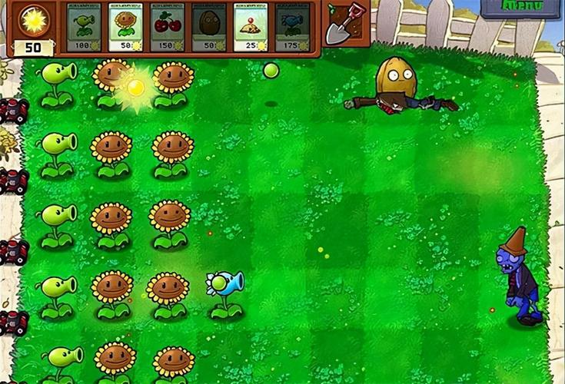
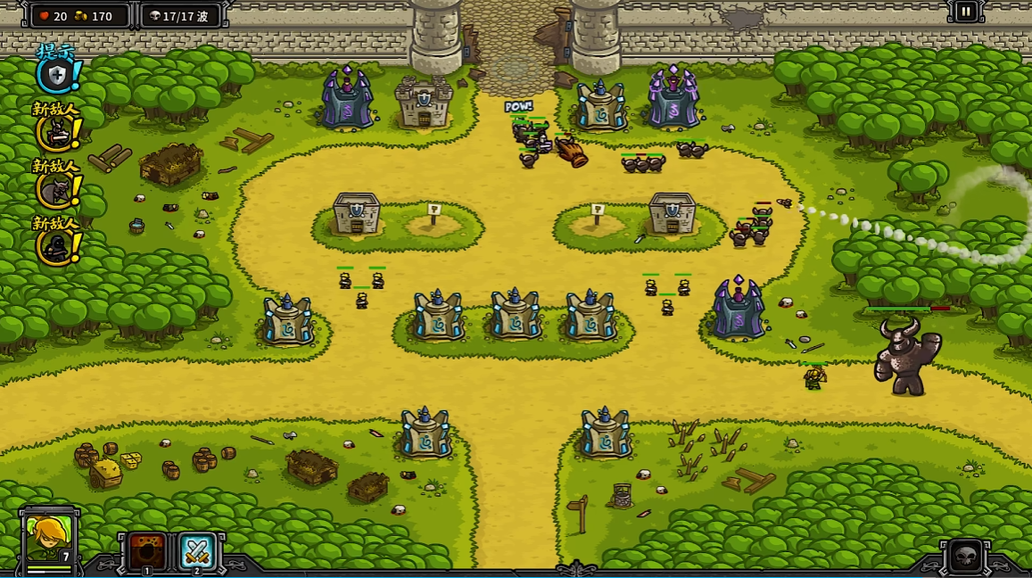
2. Tower defense
Examples:
Plants vs. Zombies Kingdom Rush

Slide 10
Challenges:
Level Design.
Designing engaging and challenging levels is crucial for maintaining player interest. The game needs to ensure that the difficulty of each level gradually increases, and introduces new types of enemies and towers to keep the game fresh.
Design of Defense Towers and Enemies.
Defense towers and enemies should each have distinct characteristics, possessing unique abilities or having relationships of counterplay. When facing different combinations of enemies, players should also use different combinations of defense towers to enhance the strategic aspect.
Balance Design.
The game needs to be carefully designed to ensure balance among all towers and enemies. This means there is no single strategy for victory, and players need to think strategically about how to use resources most effectively. The economic system in the game must be properly designed so that players have to make strategic decisions about when to upgrade, buy new towers, or save resources.

Slide 11
Challenges:
1.关卡设计。
设计有趣且富有挑战性的关卡对于保持玩家兴趣至关重要。游戏需要确保每个关卡的难度逐渐增加，并且引入新的敌人类型和塔类型以保持游戏的新鲜感。
2.防御塔与敌人设计。
防御塔和敌人应该各有特点，拥有各自独特的能力或含有克制与被克制的关系。在面对不同的敌人组合时，玩家也应使用不同的防御塔组合以增强策略性。
3.平衡设计。
游戏需要精心设计以确保所有塔和敌人之间的平衡。这意味着没有一个单一的胜利策略，玩家需要策略性地思考如何最有效地使用资源。游戏中的经济系统必须设计得当，以便玩家必须作出有关何时升级、购买新塔或保存资源的策略决策。

